Slide 1
TOPIC 4: REPETITION CONTROL STRUCTURE
Eizan Aziz
CSC128: FUNDAMENTALS OF COMPUTER PROBLEM SOLVING

Slide 2
OUTLINE
Introduction
Types of Repetition Statement
Requirements of Repetition
while loop
for loop
do...while loop
break statement
continue statement
Counter-controlled loop
Sentinel-controlled loop
Flag-controlled loop

Slide 3
Introduction
Repeat sequence of instruction many times (as long as condition is True)
Repetition = iteration = loop
Similar function, different names
Example
You have to create a simple program that will receive 5 integer inputs from user. Sum those 5 inputs and calculate the average.
Check out the C++ code with and without looping

Slide 4
Introduction
/*
Problem: Sum 5 numbers, calculate the average, display the results
*/
int num1, num2, num3, num4, num5;
int sum;
float average;
cin>>num1>>num2>>num3>>num4>>num5;
sum = num1 + num2 + num3 + num4 + num5;
average = sum / 5;
cout<<"Sum: "<<sum<<"\tAverage: "<<average;
Is this what you are thinking???

Slide 5
Introduction
Solution using looping!!!
int num, sum = 0, count = 0;
float average;
while(count < 5)
{
cout<<"Num "<<(count + 1)<<": ";
cin>>num;
sum = sum + num;
count = count + 1;
}
average = sum / 5;
cout<<"Sum: "<<sum<<"\tAverage: "<<average;

Slide 6
Types of Repetition Statement
Types of repetition
for
while
do…while

Slide 7
Types of Repetition Structure
Types of repetition structure
Counter-controlled repetition
Number of repetition is fixed (known in advance)
e.g. repeat a process 10 times
Sentinel-controlled repetition
Stop looping whenever a special value is entered
e.g. enter -1 to end the loop
Flag-controlled repetition
When a defined value is matched, it stops looping, else loop will continue
e.g. looping will continue 1000 times, however it will stop immediately if the value entered by user matches with ID = 102

Slide 8
Requirements of Repetition
/* example using while loop */
int i = 0; //initialize
while(i < 10)
{
statements;
i++;
}
Loop Control Variable (LCV)
Loop Condition
Loop Body

Slide 9
Requirements of Repetition
/* example using for loop */
for(i = 0; i < 10; i++)
{
statements;
}
Loop Control Variable (LCV)
Loop Body
Loop Condition

Slide 10
Requirements of Repetition
Loop Control Variable (LCV)
A variable whose value determines whether the loop body will be executed or not
It has initial value and increment/decrement value
Loop Condition
If the condition is true, the loop body is executed; otherwise the loop exits
Loop Body
A block of statements to be repeated

Slide 11
Requirements of Repetition
Execution of loop body is controlled by 3 operations:
Initialization of the LCV
Evaluation of LCV in the loop condition
Update of the LCV by incrementing (e.g. x++) or decrementing (e.g. x--)

Slide 12
Requirements of Repetition
Increment operator
Table 4.1: Increment operator
Common statement | Equivalent to
x++ | x = x + 1 | x += 1
- | x = x + 3 | ?
- | ? | x += 5
- | x = x + i | ?

Slide 13
Requirements of Repetition
Decrement operator
Table 4.2: Decrement operator
Common statement | Equivalent to
x-- | x = x - 1 | x -= 1
- | x = x - 9 | ?
- | ? | x -= 2
- | ? | x -= sum

Slide 14
while loop
Expression is evaluated first and then executes the statement.
If the expression is evaluate to true, it continue to be executed, and if the expression is evaluate to false, it exit the while loop.
Syntax/structure:
while(expression)
{
statements;
}

Slide 15
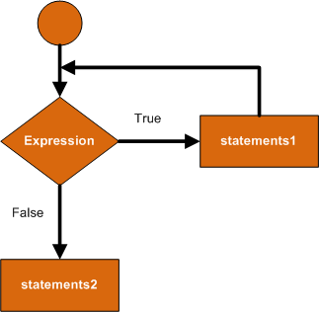
while loop
Flowchart

Slide 16
while loop
A) Initialization of LCV
C++ code segment
/* file: topic_4_while_00.cpp */
int count = 0;
while (count < 5)
{
cout<<"continue looping ";
cout<<count<<"\n";
count++;
}
cout<<"stop looping at count "<<count;
B) Evaluation of LCV in loop condition
D) Update LCV
C) Loop body

Slide 17
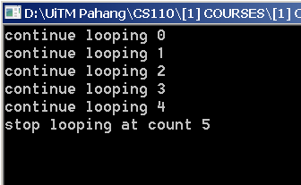
while loop
C++ output based on Slide 16

Slide 18
while loop
How to do tracing?
count | count < 5 | Statement | count++
0 | T | continue looping 0 | 1
1 | T | continue looping 1 | 2
2 | T | continue looping 2 | 3
3 | T | continue looping 3 | 4
4 | T | continue looping 4 | 5
5 | F | stop looping at count 5

Slide 19
Exercise 1 – while loop
/* file: topic_4_exe_01_while.cpp */
int num = 1, sum = 0;
while ( num < 15 )
{
sum = sum + num;
num = num + 3;
}
cout << "Total sum: " << sum;
What is the value of Total Sum?

Slide 20
Exercise 2 – while loop
/* file:topic_4_exe_02_while.cpp */
int guess;
int numberToGuess = 27;
cin >> guess;
while ( guess != numberToGuess )
{
cout << "Sorry! Wrong number.";
cout << "Keep Guessing!\n";
cin >> guess;
}
cout << "Congrats!";
Try it out at Borland C++

Slide 21
Exercise 3 – while loop
Write a program using while loop to find the sum of integers 73 through 415 inclusive
File: topic_4_exe_03_while.cpp

Slide 22
Homework 1– while loop
Homework
Make the user guess a magic number. Tell them if their number was either below or above the one they guess. If user enters correct number, stop the looping and display “Congratulation!”. Write C++ program.
File: topic_4_hw_01_while.cpp

Slide 23
Homework 2– while loop
Homework - Guess Number Game
Player will enter a special character to start and continue the game. Prompt a message to user asking to enter a guess number into the program. If guess number exactly similar to magic number, display a message “Congrats!” and use break statement to quit the iteration, else, display a message “Wrong!” and a question to continue the game. If player enters invalid special character, quit the iteration statement. Finally, display “Number of Attempt” value. In order to get number of attempt value, use counter every time player enters special character to start/continue the game.
File: topic_4_hw_02_while.cpp

Slide 24
for loop
Categorized as counter-controlled loop because it manages repetition through counting
Syntax/structure
for (initialization; condition; update LCV)
{
statements;
}
A
1
B
4
D
2, TRUE
3
C
FALSE
Quit looping & continue the rest of the program

Slide 25
for loop
How it works?
The variable(s) is initialized
The condition is checked. If true, execute statements, else terminate for loop
Execute statements within for loop
Update variables and return to step B

Slide 26
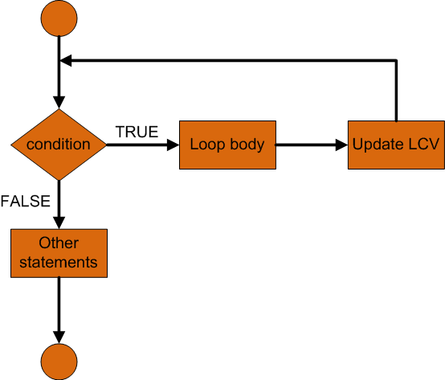
for loop
Flowchart

Slide 27
for loop
Initialization of LCV
C++ code segment
Evaluation of LCV in loop condition
/* file: topic_4_for_00.cpp */
int count;
for (count = 0 ; count < 10 ; count++)
{
cout<< "continue looping " ;
cout<< count << "\n" ;
}
cout << "stop looping at count " << count;
Loop body
Update LCV

Slide 28
Exercise 1 – for loop
/* file: topic_4_exe_01_for.cpp */
int sum = 0, num;
for( int count = 0 ; count < 5 ; count++ )
{
cout << "\nEnter a number : ";
cin >> num;
sum = sum + num;
}
cout << "\nTotal sum : " << sum;
Try it out at Borland C++

Slide 29
Exercise 2 – for loop
/* file: topic_4_exe_02_for.cpp */
int x;
cout << "The output is...\n\n";
for ( x = 0; x < 10; x++ )
{
if( x % 2 == 0)
cout << "\t *";
else
cout << "\n";
}

Slide 30
Exercise 3 – for loop
/* file: topic_4_exe_03_for.cpp */
int x, y;
cout << "The output is...\n\n";
for ( x = 0; x < 5; x++ )
{
for ( y = x; y < 5; y++ )
{
cout << "\t*";
}
cout << "\n";
}

Slide 31
Homework 1– for loop
Homework
Draw the tracing table and show the output
/* file: topic_4_hw_01_for.cpp */
#include <iostream.h>
#include <conio.h>
void main()
{
for ( int n = 1 ; n != 15 ; n++ )
{
cout << n << " ";
}
getch();
}

Slide 32
break statement
The break statement is used at the end of the cases of a switch statement to avoid flow of control falling through to the next case. It can also, but should not, be used inside the bodies of iterations.
The break statement is used to escape from an iteration loop or a switch statement.

Slide 33
break statement
Upon evaluating the expression-2 to true, the break statement will exit from the while loop resulting the statement-2 to be skipped. Next statement-3 will be executed.
Example in while loop
while ( expression-1 )
{
statement-1;
if ( expression-2 )
break;
statement-2;
}
statement-3;

Slide 34
break statement
If value of x is 1, matched with case 1, then executes statement-1. once it is done, break statement will exit from switch statement and executes statement-4.
Example in switch
int x;
cin>>x;
switch(x)
{
case 1: statement-1;
break;
case 2: statement-2;
break;
default: statement-3;
}
statement-4;

Slide 35
break statement
Test your knowledge
int x;
for (x = 1; x <= 10; x++)
{
if (x == 5)
break;
cout << x << " ";
}
cout << "\nThe loop terminated at x = " << x;
What is the output???

Slide 36
continue statement
Perform similar function as break statement but,
break statement terminate/quit the loop,
continue statement goes back to the beginning of the loop’s block to start new iteration

Slide 37
continue statement
int n;
for(int x = 0; x < 5; x++)
{
cout << "Enter a number: ";
cin >> n;
if(n == 2)
break;
else
continue;
}
cout <<"You just typed in 2!\n";
cout <<"and it called the break statement!";
If value of n is 2, looping will stop else it will continue to the next loop

Slide 38
Counter-controlled loop
Number of repetition is known in advance
e.g: repeat a process 10 times. Meaning, 1 process will be repeated 10 times.
/* example using for loop */
int x;
for (x = 0; x < 10; x++)
{
cout << "i will study hard ";
cout << "no matter how hard ";
cout << "c++ programming is.";
}

Slide 39
Counter-controlled loop
/* example using while loop */
int total, gradeCounter, grade, average;
total = 0;
gradeCounter = 1;
while (gradeCounter <= 10)
{
cout << "Enter grade: ";
cin >> grade;
total = total + grade;
gradeCounter = gradeCounter + 1;
}
average = total / 10;
cout << "Class average is " << average;

Slide 40
Logical Thinking Test
Test 1
Your program should be able to receive 2 inputs entered by user
Determine smallest and largest input
Test 2
Your program should be able to receive 3 inputs entered by user
Determine smallest and largest input

Slide 41
Exercise 1 - Counter-controlled loop
Write a complete C++ program to find smallest and largest number from a sequence of five integers input from keyboard.
Problem definition
Input: Any 5 numbers
Process: Accept the number and determine smallest and largest
Output: maximum and minimum
File: topic_04_mix_max_01.cpp

Slide 42
Exercise 2 - Counter-controlled loop
Write a complete C++ program to find the largest of sequence of integers. The number of integers is determined by user.
Problem definition
Input: number, totalNumber
Process: Accept numbers and compare to the largest
Output: largest
File: topic_04_largest_01.cpp

Slide 43
do…while loop
Execute the statements (loop body) first, then check expression/condition
Syntax/structure:
do
{
statements;
}
while(expression);

Slide 44
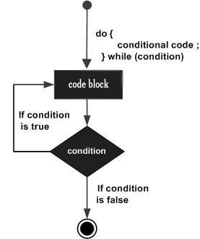
do…while loop
Flowchart

Slide 45
do…while loop
/* file: topic_4_dowhile_00.cpp */
int count = 0;
do
{
cout<<"continue looping ";
cout<<count<<"\n";
count++;
}
while (count < 5);
cout<<"stop looping at count "<<count;

Slide 46
while vs do…while
While | Do…while
Initialize Check expression Execute loop body if expression return TRUE Update LCV | Initialize Execute loop body Update LCV Check expression, if TRUE, continue execute loop body

Slide 47
Sentinel-controlled loop
Used when the exact number of repetitions is not known in advance or the items are too numerous to count beforehand.
Thus, some loops require the user to enter a special value to end the loop. This special value is called the sentinel value.
The integer and character value can be used as a sentinel value.
Refer to Homework 2 – while loop at Slide 23

Slide 48
Sentinel-controlled loop
int specialChar = 0, count = 0, sum = 0;
int average, number;
cout << "Enter a number (0 - Quit): ";
cin >> number;
while (number != specialChar)
{
sum = sum + number;
count = count + 1;
cout << "\nEnter a number (0 - Quit): ";
cin >> number;
}
average = sum / count;
cout << "\nNumber of looping: " << count;
cout << "\nAverage: "<<average;

Slide 49
Sentinel-controlled loop
int count = 0, sum = 0, average, number;
char continueChar = 'Y', specialChar;
do
{
cout << "\nEnter a number: ";
cin >> number;
sum = sum + number;
count = count + 1;
cout << "\nDo you want to continue? ";
cin >> specialChar;
} while (specialChar == continueChar);
average = sum / count;
cout << "\nNumber of looping: " << count;
cout << "\nAverage: "<<average;

Slide 50
Flag-controlled loop
A flag is a boolean variable which the value is either True or False
Syntax/structure
bool found = false; //initialize LCV
while(!found) //test LCV
{
...
...
if(expression)
found = true; //update LCV
...
...
}

Slide 51
Flag-controlled loop
int numOfPlate;
bool hungry = true;
while(hungry)
{
cout << "How much you eat? ";
cin >> numOfPlate;
if(numOfPlate < 0)
hungry = true;
else
hungry = false;
}
cout << "i am full!";

Slide 52
Flag-controlled loop
char answer;
bool finished = false;
while(!finished)
{
cout << "Did u finish ur job? ";
cin >> answer;
if(answer == 'Y' || answer == 'y')
finished = true;
else
finished = false;
}
cout << "Good job!";

Slide 53
Flag-controlled loop
int sum, number; //sum of numbers read
bool done; //used to control while loop
sum = 0; //initialize the sum
done = false; //initialize boolean variable
while( !done ) //loop while not done
{
cin >> number; //read next number
if(number > 0) //sum number if +ve
sum = sum + number; //sum the number
else
done = true; //terminate loop
}

Slide 54
Flag-controlled loop
The loop logical expression ( !done ) indicates the loop should be executed as long as done is false.

Slide 55
Flag-controlled loop
#include <iostream.h>
#include <string.h>
void main()
{
char password[7];
char myPassword[7] = {"secret"};
bool pass = false;
while (!pass)
{
cout << "\n Enter your password ";
cin >> password;

Slide 56
Flag-controlled loop
if (strcmp(password,myPassword) == 0)
{
pass = true;
}
else
{
cout << "\n\a Incorrect password";
}
} // close while loop
cout << "\n Password accepted";
} // close void main()

Slide 57
End of Topic 04

